Slide 1

Memory Pairing
Presenter:
Jiayi Shi 12642221
Yang Wu 12182919
Hao Wang 12727576

Slide 2

Framework
Targeted Audience
About the Game
Demonstration
Business Goal
Development Process
Content

Slide 3
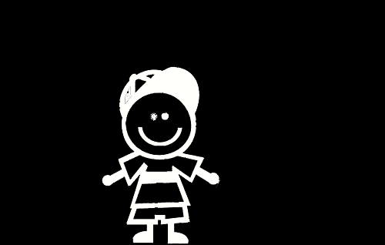
Target Audience-CHILDREN
Age: From 3 years old
Function:
Train short-term memory
Exercise concentration
Learn word
English enlightenment for children in other countries

Slide 4


Target audience-ADULT
Queuing
Waiting for a train/ bus/food
Short break
Bored or Fragments of time

Slide 5
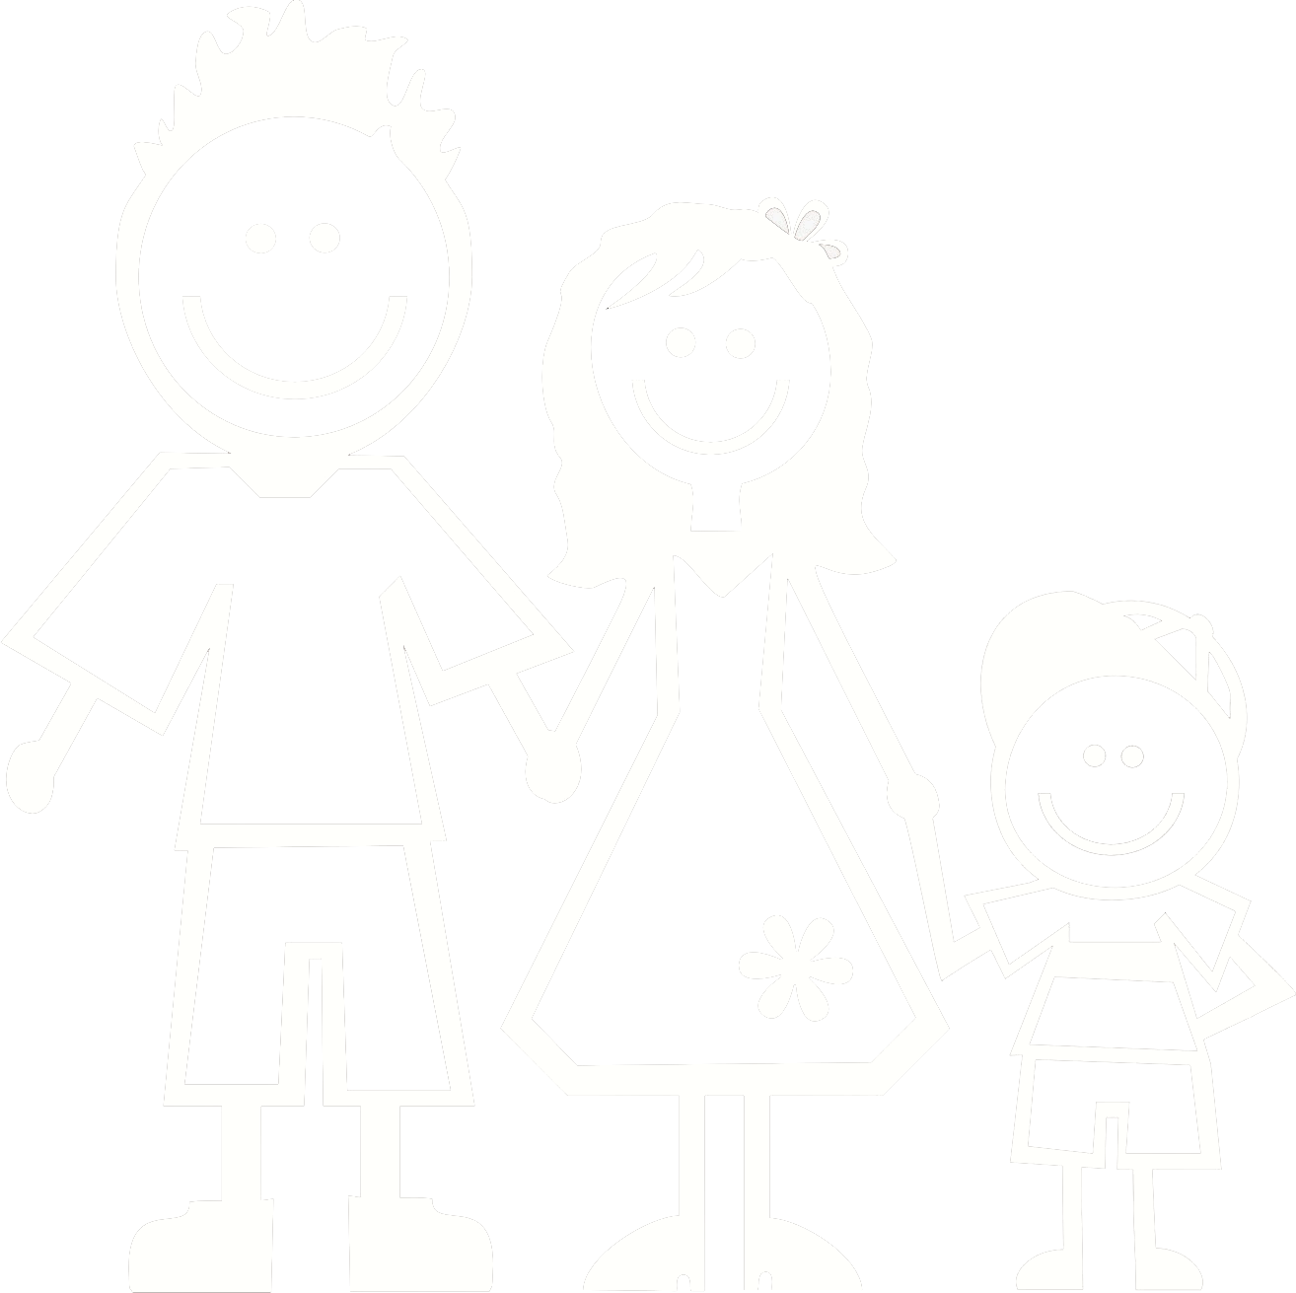
Target Audience-FAMILY
Establishing close parent-child relationship
“Family Kids and Youth” surveyed 3000 children in 25 countries. There is 38 % of children said "I hope mom and dad spend more time with me”!

Slide 6
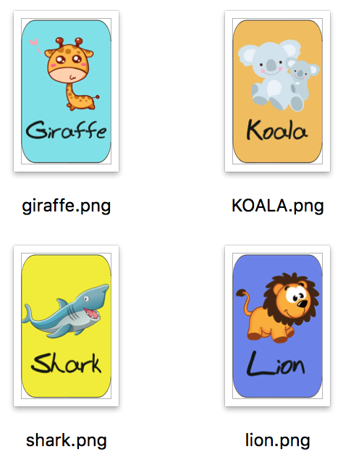
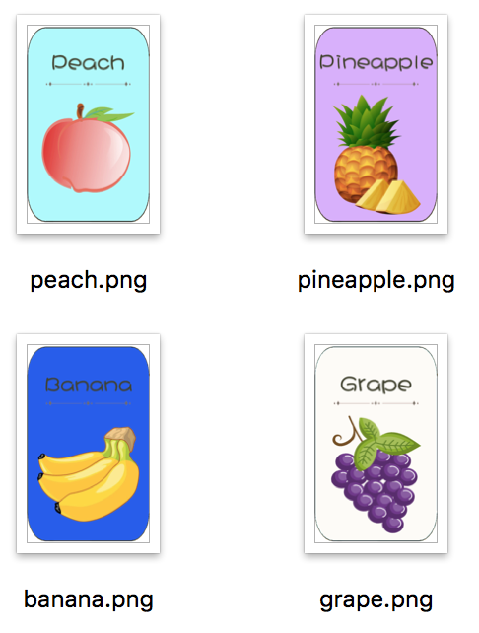
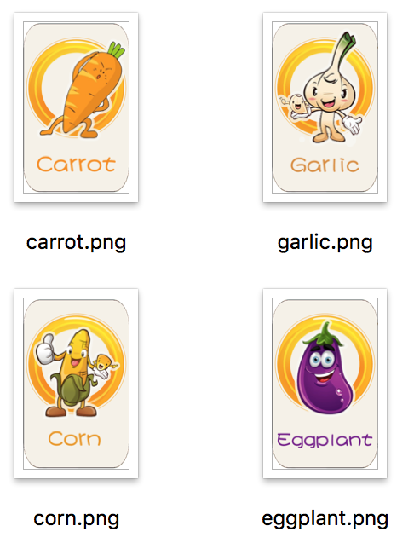
APP FUNCTION
Enriching Scenes

Slide 7








APP FUNCTION
Word Match/ Picture Match

Slide 8
APP FUNCTION
Educational Function
Enhance your memory
Exercise your brain
Strengthen your ability to respond
Double your observation ability
Use both hands and brains
Entertain yourself

Slide 9
Business Goal
Ads in Launch page /banner
Virtual Currency
Cooperate with other software

Slide 10
Demonstration

Slide 11
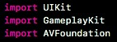
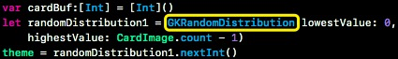
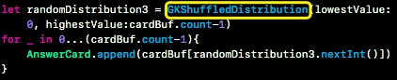
z
Framework…

Slide 12





Development Process
simple memory game for children to enhance them vocabulary
card memorizing game could practically satisfy the requirements
stage1
stage2

Slide 13


Development Process
accomplished a coarse-grained framework with basic functionalities
continuously added funny features and gradually improve the function
stage3
stage4

Slide 14
THANK
YOU
Q & A

